Slide 1
CSE419 – Artificial Intelligence and Machine Learning 2020 PhD Furkan Gözükara, Toros University https://github.com/FurkanGozukara/CSE419_2020
Lecture 14 Part 1
Logistic Regression
Based on Asst. Prof. Dr. David Kauchak (Pomona College) Lecture Slides

Slide 2
Good Regression Videos
An Introduction to Linear Regression Analysis > https://youtu.be/zPG4NjIkCjc
How to calculate linear regression using least square method > https://youtu.be/JvS2triCgOY
How to Calculate R Squared Using Regression Analysis > https://youtu.be/w2FKXOa0HGA
Standard Error of the Estimate used in Regression Analysis (Mean Square Error) > https://youtu.be/r-txC-dpI-E

Slide 3
Good Regression Videos
Statistics 101: Logistic Regression, An Introduction > https://youtu.be/zAULhNrnuL4
Statistics 101: Logistic Regression Probability, Odds, and Odds Ratio > https://youtu.be/ckkiG-SDuV8
Linear Regression Playlist > https://www.youtube.com/playlist?list=PLIeGtxpvyG-LoKUpV0fSY8BGKIMIdmfCi
Logistic Regression Playlist > https://www.youtube.com/playlist?list=PLIeGtxpvyG-JmBQ9XoFD4rs-b3hkcX7Uu

Slide 4
Good Regression Videos
StatQuest: Linear Models Pt.1 - Linear Regression > https://youtu.be/nk2CQITm_eo
StatQuest: Linear Models Pt.1.5 - Multiple Regression > https://youtu.be/zITIFTsivN8
StatQuest: Logistic Regression > https://youtu.be/yIYKR4sgzI8

Slide 5
Training revisited
From a probability standpoint, what we’re really doing when we’re training the model is selecting the Θ that maximizes:
i.e.
That we pick the most likely model parameters given the data

Slide 6
Estimating revisited
We can incorporate a prior belief in what the probabilities might be
To do this, we need to break down our probability
(Hint: Bayes rule)

Slide 7
Estimating revisited
What are each of these probabilities?

Slide 8
Priors
likelihood of the data under the model
probability of different parameters,
call the prior
probability of seeing the data (regardless of model)

Slide 9
Priors
Does p(data) matter for the argmax?
Notes:
no, it doesn’t very as theta changes. It’s a constant

Slide 10
Priors
likelihood of the data under the model
probability of different parameters,
call the prior
What does MLE assume for a prior on the model parameters?

Slide 11
Priors
likelihood of the data under the model
probability of different parameters,
call the prior
Assumes a uniform prior, i.e. all Θ are equally likely!
Relies solely on the likelihood

Slide 12
A better approach
We can use any distribution we’d like
This allows us to impart addition bias into the model

Slide 13
Another view on the prior
Remember, the max is the same if we take the log:
We can use any distribution we’d like
This allows us to impart addition bias into the model
Does this look like something we’ve seen before?

Slide 14
Regularization vs prior
likelihood based on the data
prior
fit
model bias
loss function based on the data
regularizer

Slide 15
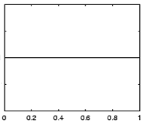
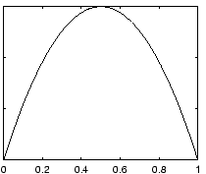
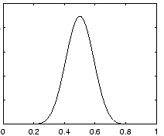
Prior for NB
Uniform prior
Dirichlet prior
λ= 0
increasing
Notes:
- as lambda gets larger we bias more and more towards

Slide 16
Prior: another view
MLE:
What happens to our likelihood if, for one of the labels, we never saw a particular feature?
Goes to 0!
Notes:
- Goes to 0!

Slide 17
Prior: another view
Adding a prior avoids this!

Slide 18
Smoothing
training data
for each label, pretend like we’ve seen each feature value occur inλadditional examples
Sometimes this is also called smoothing because it is seen as smoothing or interpolating between the MLE and some other distribution

Slide 19
Basic steps for probabilistic modeling
Probabilistic models
Step 1: pick a model
Step 2: figure out how to estimate the probabilities for the model
Step 3 (optional): deal with overfitting
Which model do we use, i.e. how do we calculate p(feature, label)?
How do train the model, i.e. how to we we estimate the probabilities for the model?
How do we deal with overfitting?

Slide 20
Joint models vs conditional models
We’ve been trying to model the joint distribution (i.e. the data generating distribution):
However, if all we’re interested in is classification, why not directly model the conditional distribution:

Slide 21
A first try: linear
Any problems with this?
- Nothing constrains it to be a probability
- Could still have combination of features and weight that exceeds 1 or is below 0
Notes:
let’s try a different route this time
rather than deriving a model (the book does it that way)
let’s start with a type of model and see if we can work our way towards a working model

Slide 22
The challenge
Linear model
probability
+∞
1
We like linear models, can we transform the probability into a function that ranges over all values?
-∞
0

Slide 23
Odds ratio
Rather than predict the probability, we can predict the ratio of 1/0 (positive/negative)
Predict the odds that it is 1 (true): How much more likely is 1 than 0.
Does this help us?

Slide 24
Odds ratio
Linear model
odds ratio
+∞
+∞
Where is the dividing line between class 1 and class 0 being selected?
-∞
0

Slide 25
Odds ratio
We’re trying to find some transformation that transforms the odds ratio to a number that is -∞ to +∞
Does this suggest another transformation?
odds ratio
0 1 2 3 4 5 6 7 8 9 ….

Slide 26
Log odds (logit function)
Linear regression
odds ratio
+∞
+∞
How do we get the probability of an example?
-∞
-∞

Slide 27
Log odds (logit function)
…
anyone recognize this?

Slide 28
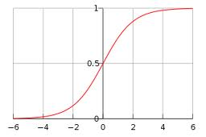
Logistic function

Slide 29
Logistic regression
How would we classify examples once we had a trained model?
If the sum > 0 then p(1)/p(0) > 1, so positive
if the sum < 0 then p(1)/p(0) < 1, so negative
Still a linear classifier (decision boundary is a line)

Slide 30
Training logistic regression models
How should we learn the parameters for logistic regression (i.e. the w’s)?
parameters

Slide 31
MLE logistic regression
Find the parameters that maximize the likelihood (or log-likelihood) of the data:
assume labels 1, -1

Slide 32
MLE logistic regression
We want to maximize, i.e.
Look familiar? Hint: anybody read the book?

Slide 33
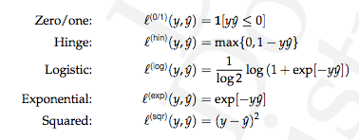
MLE logistic regression
Surrogate loss functions:

Slide 34
logistic regression: three views
linear classifier
conditional model
logistic
linear model minimizing logistic loss

Slide 35
Overfitting
If we minimize this loss function, in practice, the results aren’t great and we tend to overfit
Solution?

Slide 36
Regularization/prior
or
What are some of the regularizers we know?

Slide 37
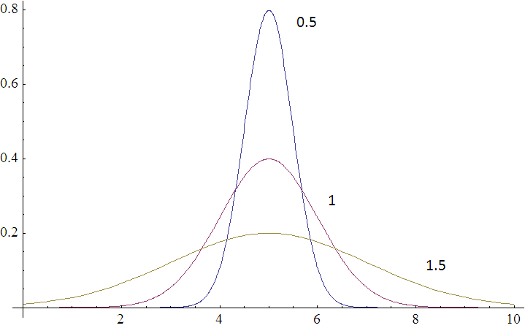
Regularization/prior
L2 regularization:
Gaussian prior:
p(w,b) ~

Slide 38
Regularization/prior
L2 regularization:
Gaussian prior:
Does theλmake sense?

Slide 39
Regularization/prior
L2 regularization:
Gaussian prior:
Notes:
Yes!
As the variance gets higher, the prior is weaker (more distributed probabilities). Higher variance = lower lambda.
As the variance gets lower, the prior is stronger (more peaked distribution). Lower variance = higher lambda.

Slide 40
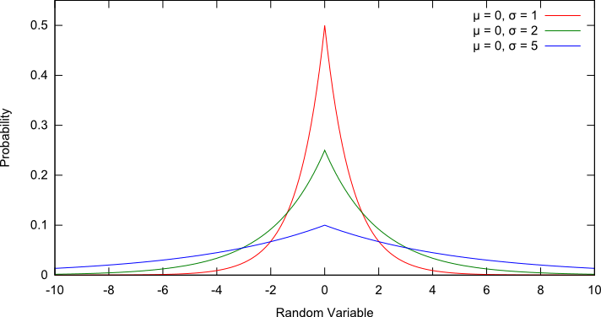
Regularization/prior
L1 regularization:
Laplacian prior:
p(w,b) ~

Slide 41
Regularization/prior
L1 regularization:
Laplacian prior:

Slide 42
L1 vs. L2
L1 = Laplacian prior
L2 = Gaussian prior

Slide 43
Logistic regression
Why is it called logistic regression?

Slide 44
A digression: regression vs. classification
Raw data
Label
features
Label
f₁, f₂, f₃, …, f_{n}
0
classification: discrete (some finite set of labels)
regression: real value
f₁, f₂, f₃, …, f_{n}
0
f₁, f₂, f₃, …, f_{n}
1
extract
features
f₁, f₂, f₃, …, f_{n}
1
f₁, f₂, f₃, …, f_{n}
0

Slide 45
linear regression
Given some points, find the line that best fits/explains the data
Our model is a line, i.e. we’re assuming a linear relationship between the feature and the label value
response (y)
f₁
How can we find this line?

Slide 46
Linear regression
Learn a line h that minimizes some loss/error function:
Sum of the individual errors:
response
(y)
0/1 loss!
feature (x)
Notes:
- squared error is optimal if we assume that the data was actually generated from a line with gaussian data

Slide 47
Error minimization
How do we find the minimum of an equation?
Take the derivative, set to 0 and solve (going to be a min or a max)
Any problems here?
Ideas?

Slide 48
Linear regression
response
squared error is convex!
feature
Notes:
- squared error is optimal if we assume that the data was actually generated from a line with gaussian data

Slide 49
Linear regression
Learn a line h that minimizes an error function:
response
in the case of a 2d line:
function for a line
feature
Notes:
- squared error is optimal if we assume that the data was actually generated from a line with gaussian data

Slide 50
Linear regression
We’d like to minimize the error
Find w₁ and w₀ such that the error is minimized
We can solve this in closed form

Slide 51
Multiple linear regression
If we have m features, then we have a line in m dimensions
weights

Slide 52
Multiple linear regression
We can still calculate the squared error like before
Still can solve this exactly!

Slide 53
Logistic function

Slide 54
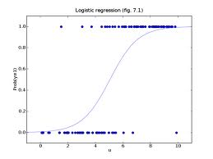
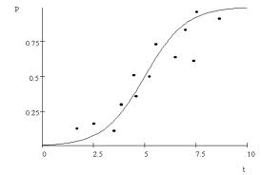
Logistic regression
Find the best fit of the data based on a logistic

Slide 55
CSE419 – Artificial Intelligence and Machine Learning 2020 PhD Furkan Gözükara, Toros University https://github.com/FurkanGozukara/CSE419_2020
Lecture 14 Part 2
Ensemble Learning
Based on Asst. Prof. Dr. David Kauchak (Pomona College) Lecture Slides

Slide 56
Ensemble learning
Basic idea: if one classifier works well, why not use multiple classifiers!

Slide 57
Ensemble learning
Basic idea: if one classifier works well, why not use multiple classifiers!
Training
learning alg
model 1
learning alg
model 2
Training
Data
…
learning alg
model m

Slide 58
Ensemble learning
Basic idea: if one classifier works well, why not use multiple classifiers!
Testing
model 1
prediction 1
example to label
model 2
prediction 2
How do we decide on the final prediction?
…
model m
prediction m

Slide 59
Ensemble learning
Basic idea: if one classifier works well, why not use multiple classifiers!
Testing
prediction 1
take majority vote
if they output probabilities, take a weighted vote
prediction 2
…
How does having multiple classifiers help us?
prediction m

Slide 60
Benefits of ensemble learning
Assume each classifier makes a mistake with some probability (e.g. 0.4, that is a 40% error rate)
model 1
Assuming the decisions made between classifiers are independent, what will be the probability that we make a mistake (i.e. error rate) with three classifiers for a binary classification problem?
model 2
model 3

Slide 61
Benefits of ensemble learning
Assume each classifier makes a mistake with some probability (e.g. 0.4, that is a 40% error rate)
model 1 | model 2 | model 3 | prob
C | C | C | .6*.6*.6=0.216
C | C | I | .6*.6*.4=0.144
C | I | C | .6*.4*.6=0.144
C | I | I | .6*.4*.4=0.096
I | C | C | .4*.6*.6=0.144
I | C | I | .4*.6*.4=0.096
I | I | C | .4*.4*.6=0.096
I | I | I | .4*.4*.4=0.064

Slide 62
Benefits of ensemble learning
Assume each classifier makes a mistake with some probability (e.g. 0.4, that is a 40% error rate)
model 1 | model 2 | model 3 | prob
C | C | C | .6*.6*.6=0.216
C | C | I | .6*.6*.4=0.144
C | I | C | .6*.4*.6=0.144
C | I | I | .6*.4*.4=0.096
I | C | C | .4*.6*.6=0.144
I | C | I | .4*.6*.4=0.096
I | I | C | .4*.4*.6=0.096
I | I | I | .4*.4*.4=0.064
0.096+
0.096+
0.096+
0.064 =
35% error!

Slide 63
Benefits of ensemble learning
3 classifiers in general, for r = probability of mistake for individual classifier:
binomial distribution
r | p(error)
0.4 | 0.35
0.3 | 0.22
0.2 | 0.10
0.1 | 0.028
0.05 | 0.0073

Slide 64
Benefits of ensemble learning
5 classifiers in general, for r = probability of mistake for individual classifier:
r | p(error) 3 classifiers | p(error) 5 classifiers
0.4 | 0.35 | 0.32
0.3 | 0.22 | 0.16
0.2 | 0.10 | 0.06
0.1 | 0.028 | 0.0086
0.05 | 0.0073 | 0.0012

Slide 65
Benefits of ensemble learning
m classifiers in general, for r = probability of mistake for individual classifier:
(cumulative probability distribution for the binomial distribution)

Slide 66
Given enough classifiers…
r = 0.4

Slide 67
Obtaining independent classifiers
learning alg
model 1
learning alg
model 2
Training
Data
…
learning alg
model m
Where to we get m independent classifiers?

Slide 68
Idea 1: different learning methods
model 1
decision tree
learning alg
k-nn
learning alg
model 2
Training
Data
perceptron
…
naïve bayes
model m
gradient descent variant 1
learning alg
gradient descent variant 2
Pros/cons?
…

Slide 69
Idea 1: different learning methods
Pros:
Lots of existing classifiers already
Can work well for some problems
Cons/concerns:
Often, classifiers are not independent, that is, they make the same mistakes!
e.g. many of these classifiers are linear models
voting won’t help us if they’re making the same mistakes

Slide 70
Idea 2: split up training data
part 1
learning alg
model 1
part 2
learning alg
model 2
Training
Data
…
…
part m
learning alg
model m
Use the same learning algorithm, but train on different parts of the training data

Slide 71
Idea 2: split up training data
Pros:
Learning from different data, so can’t overfit to same examples
Easy to implement
fast
Cons/concerns:
Each classifier is only training on a small amount of data
Not clear why this would do any better than training on full data and using good regularization

Slide 72
Idea 3: bagging
Training
Data 1
learning alg
model 1
…
Training
Data
…
learning alg
model m
Training
Data m

Slide 73



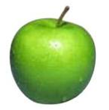
data generating distribution
Training data
Test set
data generating distribution

Slide 74
Ideal situation
Training data 1
Training data 2
…
data generating distribution
Notes:
but we can’t do this ☹

Slide 75
bagging
“Training” data 1
“Training” data 2
…
Training data
Use training data as a proxy for the data generating distribution
Notes:
pretend like the training data defines out data generating distribution
sample with replacement to generate new “training” data sets

Slide 76
sampling with replacements
“Training” data 1
Training data

Slide 77
sampling with replacements
“Training” data 1
pick a random example from the real training data
Training data

Slide 78
sampling with replacements
“Training” data 1
add it to the new “training” data
Training data

Slide 79
sampling with replacements
“Training” data 1
put it back (i.e. leave it) in the original training data
Training data

Slide 80
sampling with replacements
“Training” data 1
pick another random example
Training data

Slide 81
sampling with replacements
“Training” data 1
pick another random example
Training data

Slide 82
sampling with replacements
“Training” data 1
keep going until you’ve created a new “training” data set
Training data

Slide 83
bagging
create m “new” training data sets by sampling with replacement from the original training data set (called m “bootstrap” samples)
train a classifier on each of these data sets
to classify, take the majority vote from the m classifiers

Slide 84
bagging concerns
Training
Data 1
Won’t these all be basically the same?
Training
Data
…
Training
Data m

Slide 85
bagging concerns
For a data set of size n, what is the probability that a given example will NOT be select in a “new” training set sampled from the original?
Training data

Slide 86
bagging concerns
What is the probability it isn’t chosen the first time?
Training data

Slide 87
bagging concerns
What is the probability it isn’t chosen the any of the n times?
Each draw is independent and has the same probability
Training data

Slide 88
probability of overlap
Converges very quickly to 1/e ≈ 63%

Slide 89
bagging overlap
Training
Data 1
Won’t these all be basically the same?
Training
Data
…
On average, a randomly sampled data set will only contain 63% of the examples in the original
Training
Data m

Slide 90
When does bagging work
Let’s say 10% of our examples are noisy (i.e. don’t provide good information)
For each of the “new” data set, what proportion of noisy examples will they have?
They’ll still have ~10% of the examples as noisy
However, these examples will only represent about a third of the original noisy examples
For some classifiers that have trouble with noisy classifiers, this can help

Slide 91
When does bagging work
Bagging tends to reduce the variance of the classifier
By voting, the classifiers are more robust to noisy examples
Bagging is most useful for classifiers that are:
Unstable: small changes in the training set produce very different models
Prone to overfitting
Often has similar effect to regularization
Notes:
which methods that we’ve seen so far are more unstable?
decision trees

Slide 92
CSE419 – Artificial Intelligence and Machine Learning 2020 PhD Furkan Gözükara, Toros University https://github.com/FurkanGozukara/CSE419_2020
Lecture 14 Part 3
Boosting
Based on Asst. Prof. Dr. David Kauchak (Pomona College) Lecture Slides

Slide 93
Ensemble learning
Basic idea: if one classifier works well, why not use multiple classifiers!

Slide 94
Ensemble learning
Basic idea: if one classifier works well, why not use multiple classifiers!
Training
learning alg
model 1
learning alg
model 2
Training
Data
…
learning alg
model m

Slide 95
Ensemble learning
Basic idea: if one classifier works well, why not use multiple classifiers!
Testing
model 1
prediction 1
example to label
model 2
prediction 2
…
model m
prediction m

Slide 96
Idea 4: boosting
training data
“training” data 2
“training” data 3
Data
Label
Weight
Data
Label
Weight
Data
Label
Weight
0
0.2
0
0.1
0
0.05
0
0.2
0
0.1
0
0.2
1
0.2
1
0.4
1
0.2
1
0.2
1
0.1
1
0.05
0
0.2
0
0.3
0
0.5

Slide 97

“Strong” learner
Given
a reasonable amount of training data
a target error rate ε
a failure probability p
A strong learning algorithm will produce a classifier with error rate <ε with probability 1-p

Slide 98

“Weak” learner
Given
a reasonable amount of training data
a failure probability p
A weak learning algorithm will produce a classifier with error rate < 0.5 with probability 1-p
Weak learners are much easier to create!

Slide 99
weak learners for boosting
Data
Label
Weight
0
0.2
0
0.2
weak learning algorithm
weak classifier
1
0.2
1
0.2
Which of our algorithms can handle weights?
0
0.2
Need a weak learning algorithm that can handle weighted examples

Slide 100
boosting: basic algorithm
Training:
start with equal example weights
for some number of iterations:
learn a weak classifier and save
change the example weights
Classify:
get prediction from all learned weak classifiers
weighted vote based on how well the weak classifier did when it was trained

Slide 101
boosting basics
Start with equal weighted examples
Weights:
Examples:
E1
E2
E3
E4
E5
Learn a weak classifier:
weak 1

Slide 102
Boosting
classified correct
classified incorrect
Weights:
Examples:
E1
E2
E3
E4
E5
We want to reweight the examples and then learn another weak classifier
How should we change the example weights?
weak 1

Slide 103
Boosting
Weights:
Examples:
E1
E2
E3
E4
E5
decrease the weight for those we’re getting correct
increase the weight for those we’re getting incorrect

Slide 104
Boosting
Weights:
Examples:
E1
E2
E3
E4
E5
Learn another weak classifier:
weak 2

Slide 105
Boosting
Weights:
Examples:
E1
E2
E3
E4
E5
weak 2

Slide 106
Boosting
Weights:
Examples:
E1
E2
E3
E4
E5
decrease the weight for those we’re getting correct
increase the weight for those we’re getting incorrect

Slide 107
Classifying
weak 1
prediction 1
weighted vote based on how well they classify the training data
weak 2
prediction 2
weak_2_vote > weak_1_vote since it got more right
…

Slide 108
Notation
x_{i} example i in the training data
w_{i} weight for example i, we will enforce:
classifier_{k}(x_{i}) +1/-1 prediction of classifier k example i

Slide 109
AdaBoost: train
for k = 1 to iterations:
classifier_{k} = learn a weak classifier based on weights
calculate weighted error for this classifier
calculate “score” for this classifier:
change the example weights

Slide 110
AdaBoost: train
classifier_{k} = learn a weak classifier based on weights
weighted error for this classifier is:
What does this say?

Slide 111
AdaBoost: train
classifier_{k} = learn a weak classifier based on weights
weighted error for this classifier is:
What is the range of possible values?
prediction
did we get the example wrong
weighted sum of the errors/mistakes

Slide 112
AdaBoost: train
classifier_{k} = learn a weak classifier based on weights
weighted error for this classifier is:
Between 0, if we get all examples right, and 1, if we get them all wrong
prediction
did we get the example wrong
weighted sum of the errors/mistakes

Slide 113
AdaBoost: train
classifier_{k} = learn a weak classifier based on weights
“score” or weight for this classifier is:
What does this look like (specifically for errors between 0 and 1)?

Slide 114
AdaBoost: train
ranges from 1 to -1
errors of 50% = 0

Slide 115
AdaBoost: classify
What does this do?

Slide 116
AdaBoost: classify
The weighted vote of the learned classifiers weighted by α(remember αvaries from 1 to -1 training error)
What happens if a classifier has error >50%

Slide 117
AdaBoost: classify
The weighted vote of the learned classifiers weighted by α(remember αvaries from 1 to -1 training error)
We actually vote the opposite!

Slide 118
AdaBoost: train, updating the weights
update the example weights
Remember, we want to enforce:
Z is called the normalizing constant. It is used to make sure that the weights sum to 1
What should it be?

Slide 119
AdaBoost: train
update the example weights
Remember, we want to enforce:
normalizing constant (i.e. the sum of the “new” w_{i}):

Slide 120
AdaBoost: train
update the example weights
What does this do?

Slide 121
AdaBoost: train
update the example weights
correct positive
incorrect negative
correct
incorrect
?

Slide 122
AdaBoost: train
update the example weights
correct positive
incorrect negative
Note: only change weights based on current classifier (not all previous classifiers)
correct small value
incorrect large value

Slide 123
AdaBoost: train
update the example weights
What does the αdo?

Slide 124
AdaBoost: train
update the example weights
What does the αdo?
If the classifier was good (<50% error)αis positive:
trust classifier output and move as normal
If the classifier was back (>50% error)αis negative
classifier is so bad, consider opposite prediction of classifier

Slide 125
AdaBoost: train
update the example weights
correct positive
incorrect negative
correct small value
incorrect large value
If the classifier was good (<50% error)αis positive
If the classifier was back (>50% error)αis negative

Slide 126
AdaBoost justification
update the example weights
Does this look like anything we’ve seen before?

Slide 127
AdaBoost justification
update the example weights
Exponential loss!
AdaBoost turns out to be another approach for minimizing the exponential loss!

Slide 128
Other boosting variants
Adaboost =
Logitboost
Loss
Brownboost
0-1 loss
loss
Mistakes
Correct
Notes:
- many other “boosting” variants besides AdaBoost that can all be equated to different surrogate loss functions

Slide 129
Boosting example
Start with equal weighted data set

Slide 130
Boosting example
weak learner = line
What would be the best line learned on this data set?
h => p(error) = 0.5 it is at chance

Slide 131
Boosting example
How should we reweight examples?
This one seems to be the best
This is a ‘weak classifier’: It performs slightly better than chance.

Slide 132
Boosting example
What would be the best line learned on this data set?
reds on this side get less weight
blues on this side get more weight
reds on this side get more weight
blues on this side get less weight

Slide 133
Boosting example
How should we reweight examples?

Slide 134
Boosting example
What would be the best line learned on this data set?

Slide 135
Boosting example

Slide 136
Boosting example
f₁
f₂
f₄
f₃
The strong (non- linear) classifier is built as the combination of all the weak (linear) classifiers.

Slide 137
AdaBoost: train
for k = 1 to iterations:
classifier_{k} = learn a weak classifier based on weights
weighted error for this classifier is:
“score” or weight for this classifier is:
change the example weights
What can we use as a classifier?
Notes:
- what can we use as a classifier?

Slide 138
AdaBoost: train
for k = 1 to iterations:
classifier_{k} = learn a weak classifier based on weights
weighted error for this classifier is:
“score” or weight for this classifier is:
change the example weights
Anything that can train on weighted examples
For most applications, must be fast!
Why?
Notes:
- what can we use as a classifier?

Slide 139
AdaBoost: train
for k = 1 to iterations:
classifier_{k} = learn a weak classifier based on weights
weighted error for this classifier is:
“score” or weight for this classifier is:
change the example weights
Anything that can train on weighted examples
For most applications, must be fast!
Each iteration we have to train a new classifier
Notes:
- what can we use as a classifier?

Slide 140
Boosted decision stumps
One of the most common classifiers to use is a decision tree:
can use a shallow (2-3 level tree)
even more common is a 1-level tree
called a decision stump ☺
asks a question about a single feature
What does the decision boundary look like for a decision stump?

Slide 141
Boosted decision stumps
One of the most common classifiers to use is a decision tree:
can use a shallow (2-3 level tree)
even more common is a 1-level tree
called a decision stump ☺
asks a question about a single feature
What does the decision boundary look like for boosted decision stumps?

Slide 142
Boosted decision stumps
One of the most common classifiers to use is a decision tree:
can use a shallow (2-3 level tree)
even more common is a 1-level tree
called a decision stump ☺
asks a question about a single feature
Linear classifier!
Each stump defines the weight for that dimension
If you learn multiple stumps for that dimension then it’s the weighted average

Slide 143
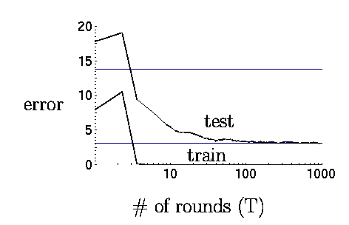
Boosting in practice
Very successful on a wide range of problems
One of the keys is that boosting tends not to overfit, even for a large number of iterations
Using <10,000 training examples can fit >2,000,000 parameters!

Slide 144

Adaboost application example: face detection

Slide 145
Adaboost application example: face detection

Slide 146
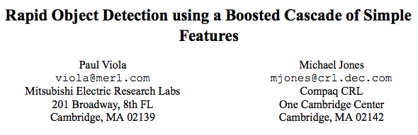
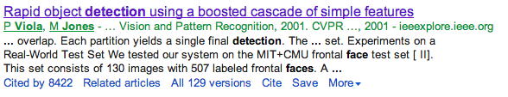

Slide 147

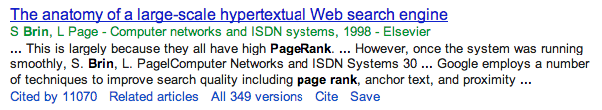
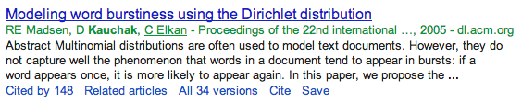
To give you some context of importance:
or:

Slide 148
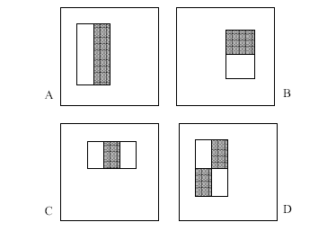
“weak” learners
4 Types of “Rectangle filters” (Similar to Haar wavelets
Papageorgiou, et al. )
Based on 24x24 grid: 160,000 features to choose from
g(x) =
sum(WhiteArea) - sum(BlackArea)

Slide 149
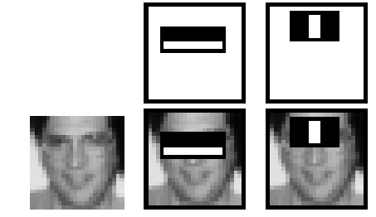
“weak” learners
F(x) = α₁ f₁(x) + α₂ f₂(x) + ...
1 if g_{i}(x) > θ_{i}
-1 otherwise
f_{i}(x) =

Slide 150
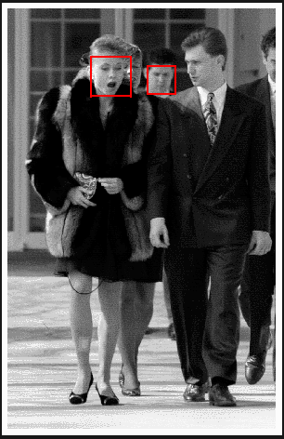

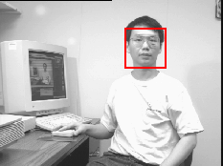
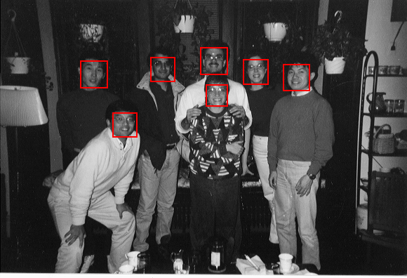
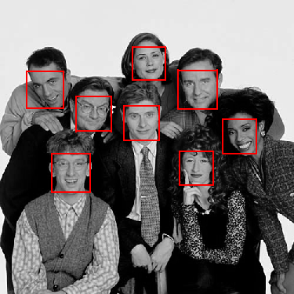
Example output

Slide 151
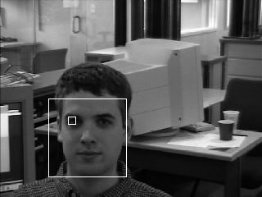
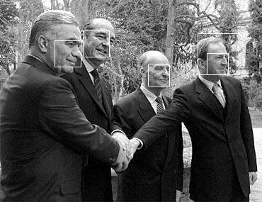
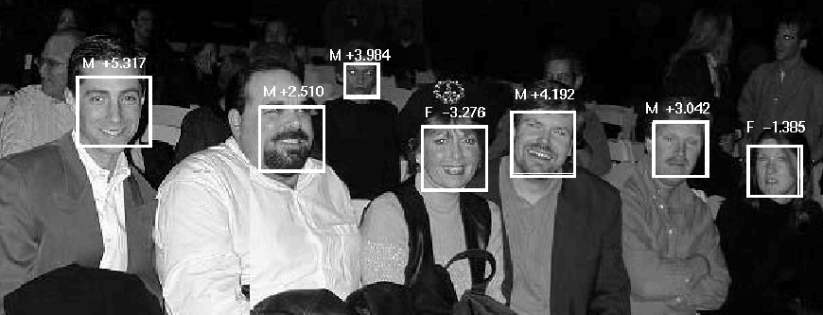
Solving other “Face” Tasks
Facial Feature Localization
Profile Detection
Demographic
Analysis

Slide 152
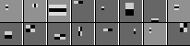
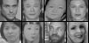
“weak” classifiers learned

Slide 153
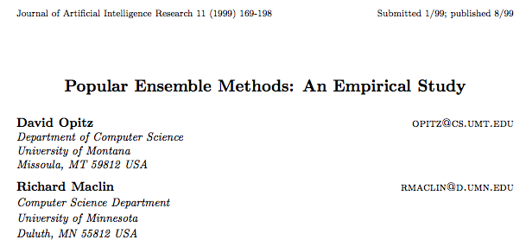
Bagging vs Boosting
http://arxiv.org/pdf/1106.0257.pdf

Slide 154
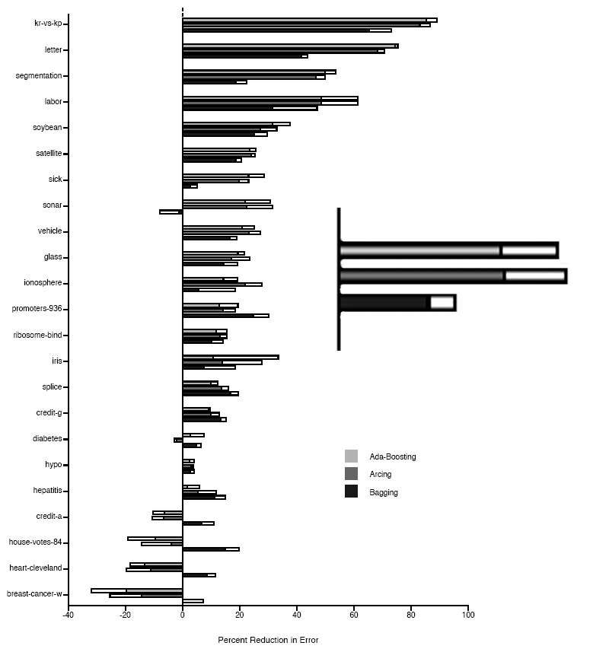
Boosting Neural Networks
Change in error rate over standard classifier
Ada-Boosting
Arcing
Bagging
White bar represents 1
standard deviation

Slide 155
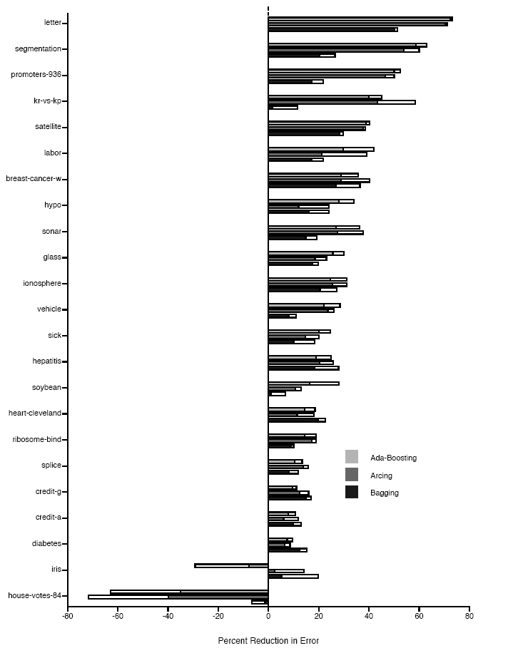
Boosting Decision Trees

Slide 156
Useful Videos
Extending Machine Learning Algorithms – AdaBoost Classifier > https://youtu.be/BoGNyWW9-mE
Ensembles (4): AdaBoost > https://youtu.be/ix6IvwbVpw0
Principles of Machine Learning | AdaBoost > https://youtu.be/-DUxtdeCiB4

